Slide 1
SQL
Mustafa Elmas

Slide 2
Motivation

Slide 3
Delivery
deliveryId
deliveryDate
supplierId
OrderDetailDelivery
deliveryId
orderId
orderDetailId
Supplier
deliveryId
deliveryDate
supplierId
OrderDetail
orderDetailId
productId
orderId
productQuantity
Order
orderId
orderDate
HeadQuartersId
Product
productId
supplierId
HeadQuarters
HeadQuartersId
branchId
Branch
branchId

Slide 4
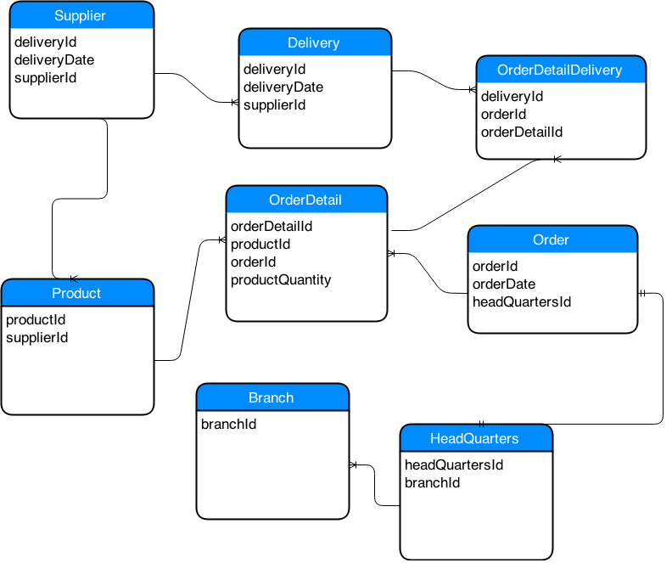

Slide 5
Agenda
Introduction to SQL
Joins
CASE statement
Subqueries
Common Table Expressions (CTEs)
Window Functions
Reporting

Slide 6
Introduction to SQL

Slide 7
Relational Database Management Systems
A Relational Database Management Systems (RDBMS) is a database management system (DBMS) that is based on the relational model. There are various types of database systems such as MySQL, MS Access, Oracle, Sybase, Informix, Postgres and SQL Server.
A database is a collection of tables.
Tables are two-dimensional with rows (observations) and columns (variables).
Spreadsheets such as in csv or excel format can be thought as Tables.

Slide 8
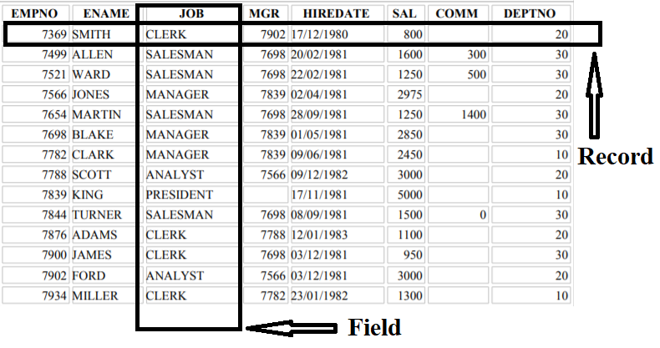
Tables
What is a Record or Row?
It is each individual entry (horizontal entity) that exists in a table.
What is a field or attribute?
It is a column (vertical entity) in a table that is designed to maintain specific information about every record in the table.

Slide 9
SQL
It is the standard language for the RDBMS
It is designed for storing, manipulating and retrieving data in a relational database.
It stands for Structured Query Language
It is pronounced as “ess-que-ell" or "sequel"

Slide 10
Basic Data Types
A data type specifies a particular type of data, such as string (Ashley), integer (63), floating-point (5.34), Boolean (True or False) etc.
A data type also specifies the possible values for that type, the operations that can be performed on that type.
Some of the data types in Oracle database are the following: CHAR, NUMBER, FLOAT, DATE and TIMESTAMP.

Slide 11
Keywords and Clauses
SQL Server uses reserved words for database operations. Keywords in red color are called SQL clauses.
SELECT
FROM
WHERE
AND
OR
BETWEEN
CASE
AS
LIMIT, TOP, ROWNUM
DISTINCT
COUNT
IN
IS NULL, IS NOT NULL
LIKE
ORDER BY
GROUP BY
HAVING
ASC
DESC
JOIN
UNION, UNION ALL

Slide 12
Concept
Selecting all columns and rows from a table
Selecting specific columns from a table
Aggregating data
Ordering data
Finding unique values
Filtering data
Selecting or Excluding null values
Doing Arithmetic Operations (Math)
Joining data from multiple tables

Slide 13
Writing SQL Statements (Query)
Use the following simple rules and guidelines to construct valid sql queries that are both easy to read and edit:
SQL statements are usually NOT case sensitive. If you are working with MySQL, then you need to type table names as they exist in the database.
SQL statements can be entered on one or many lines.
Keywords cannot be split across lines or abbreviated.
Keywords are typically typed in uppercase; all others, such as table names and columns, are typed in lowercase.
Clauses are usually placed on separate lines for readability and ease of editing.
Tabs and indents can be used to enhance readability.
Some interfaces require each statement to end with a semicolon.

Slide 14
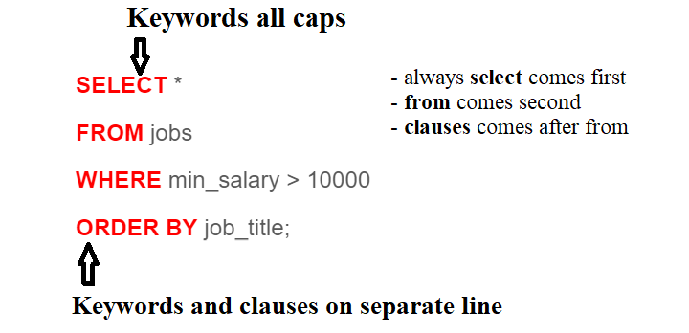
A sample SQL query

Slide 15
SELECT
The SELECT statement is used to select data from a table.
Selecting All Columns
SELECT country_id, country_name, region_id
FROM countries;

Slide 16
SELECT continued
Selecting All Columns, All Rows
SELECT *
FROM countries;
Selecting Specific Columns
SELECT country_id, country_name
FROM countries;

Slide 17
DISTINCT
The SELECT DISTINCT statement is used to return only distinct values.
Select all distinct job ids.
SELECT DISTINCT job_id
FROM job_history;

